Slide 1
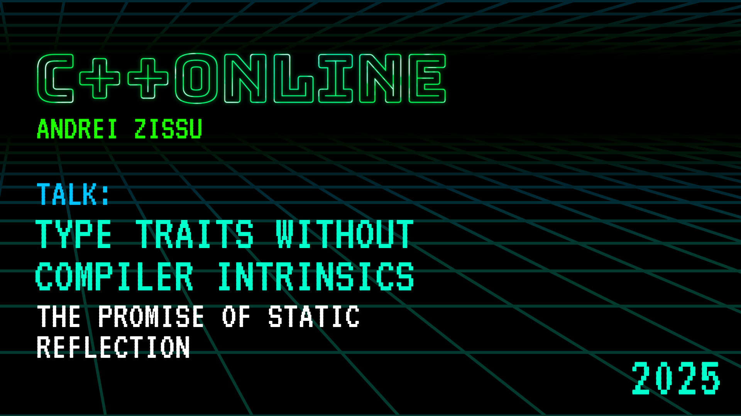

Slide 2

Agenda
Introduction to Type Traits
Template-based Implementations
Type Traits Implemented via Compiler Internals
Static Reflection
Reflection and Type Traits
Summary and Future Directions

Slide 3
Who am I
Andrei Zissu
Israeli C++ developer for over 2 decades, born in Romania
Worked in multiple industries, inc. embedded & defensive cyber
WG21 member for the past 3 years, mainly interested in reflection and contracts
Tech Lead at Morphisec, provider of Automatic Moving Target Defense (AMTD)
The views expressed in this talk are mine and mine only (hopefully yours too by the time we’re done here)

Slide 4
Introduction to Type Traits

Slide 5
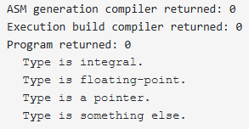
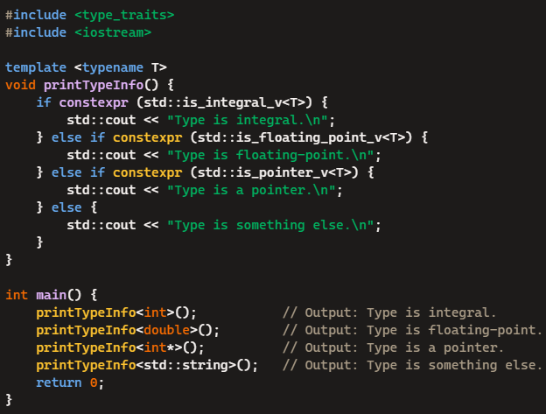

Slide 6
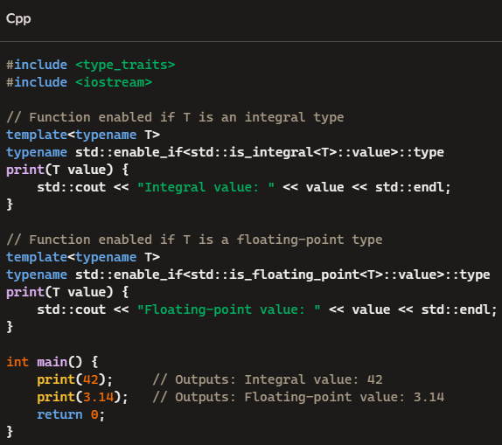
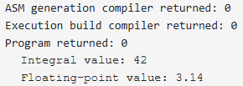

Slide 7
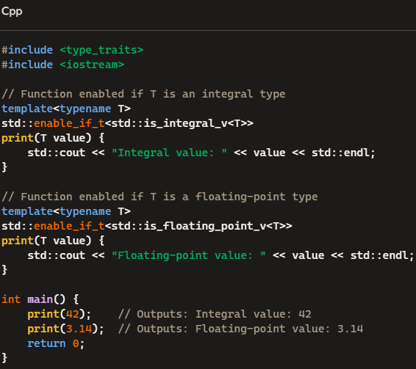

Slide 8
Primary Type Categories
is_class
Checks if a type is a class
is_void
Checks if a type is void
is_integral
Checks if a type is an integral type

Slide 9
Primary Type Categories
is_function
Checks if a type is a function type
is_pointer
Checks if a type is a pointer type
is_lvalue_reference
Checks if a type is an lvalue reference

Slide 10
Composite Type Categories
is_scalar
Checks if a type is a scalar type
is_reference
Checks if a type is either an lvalue reference or rvalue reference
is_member_pointer
Checks if a type is a pointer to a non-static member function or object

Slide 11
Type Properties
is_final
Checks if a type is a final class type
is_const
Checks if a type is const-qualified
is_empty
checks if a type is a class (but not union) type and has no non-static data members

Slide 12
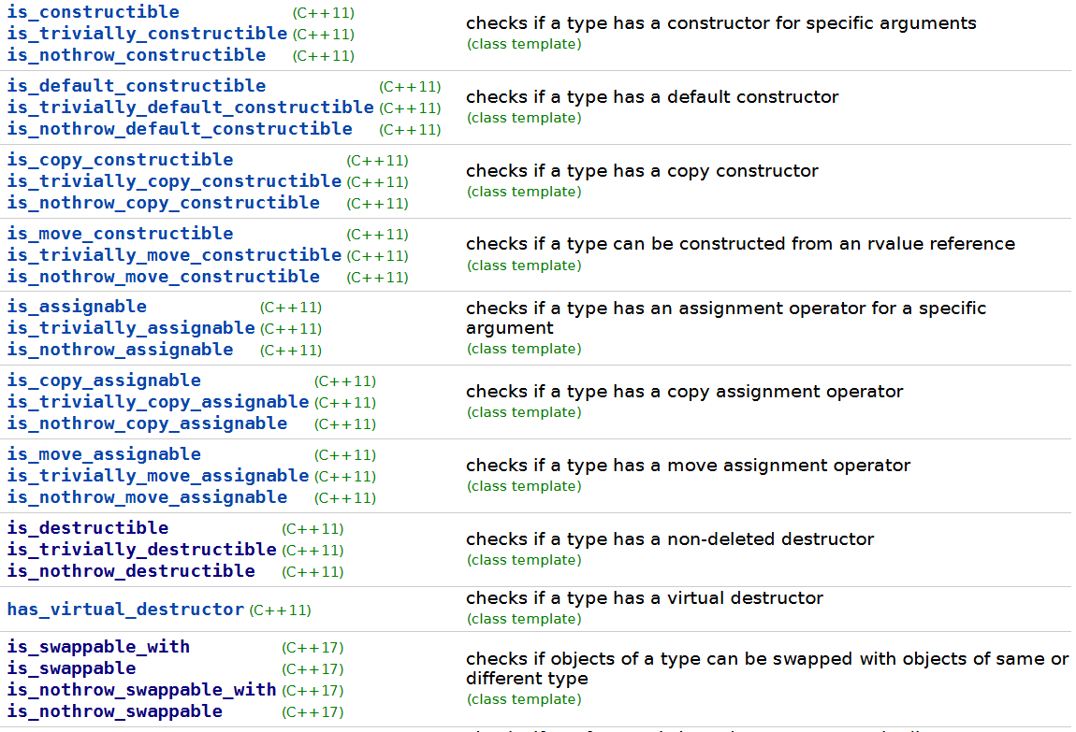
Supported Operations

Slide 13
Type Relationships
is_same
Checks if two types are the same
is_base_of
Checks if a type is a base of the other type
is_convertible
Checks if a type can be converted to the other type

Slide 14
Type Transformations
remove_cv
Removes const and/or volatile specifiers from the given type
add_lvalue_reference
Adds an lvalue reference to the given type
make_signed
Obtains the corresponding signed type for the given integral type

Slide 15
Notes
Intrinsic -> built-in, "magic“
Libcxx
Accompanies clang
Libstd
Accompanies gcc
MSVC STL
Accompanies MS Visual Studio
Many standard concepts are built on top of type traits
Door to AST

Slide 16
Overall Implementation Strategies
Templates
Intrinsics
Mixed

Slide 17
Template-based Implementations

Slide 18

Basic Building Blocks: integral_constant, bool_constant enable_if

Slide 19
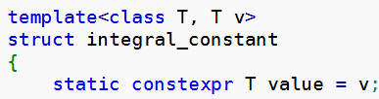
std::integral_constant

Slide 20
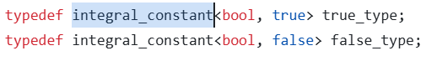
std::integral_constant

Slide 21
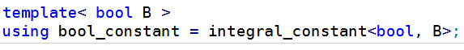
std::integral_constant

Slide 22
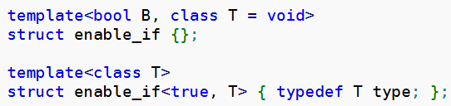
std::enable_if

Slide 23
std::enable_if

Slide 24
std::enable_if
Substitution Failure Is Not An Error - SFINAE

Slide 26
Implementing helper variable templates

Slide 27

Structs

Slide 28
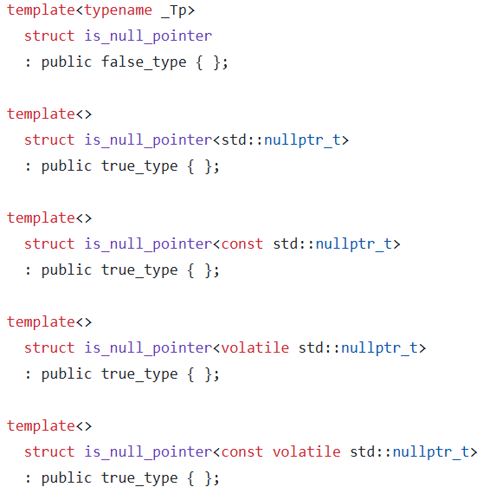
std::is_null_pointer (gcc)

Slide 29
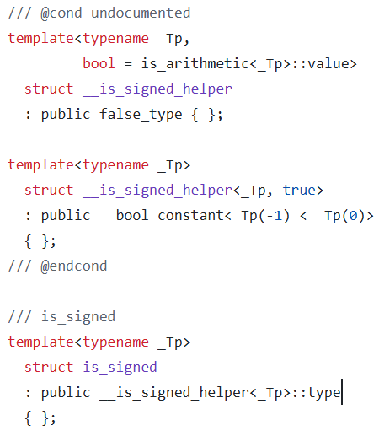
std::is_signed (gcc)

Slide 30
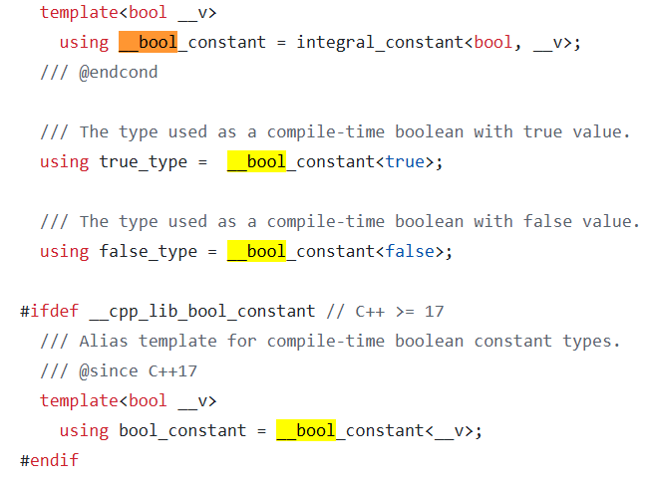
std::bool_constant (gcc)

Slide 31

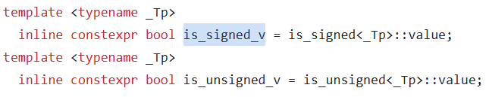
Variables

Slide 32
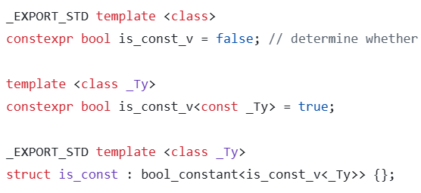
std::is_const (msvc)

Slide 33
Type Traits Implemented via Compiler Internals

Slide 34

Some code from the 3 big compilers/libraries

Slide 35
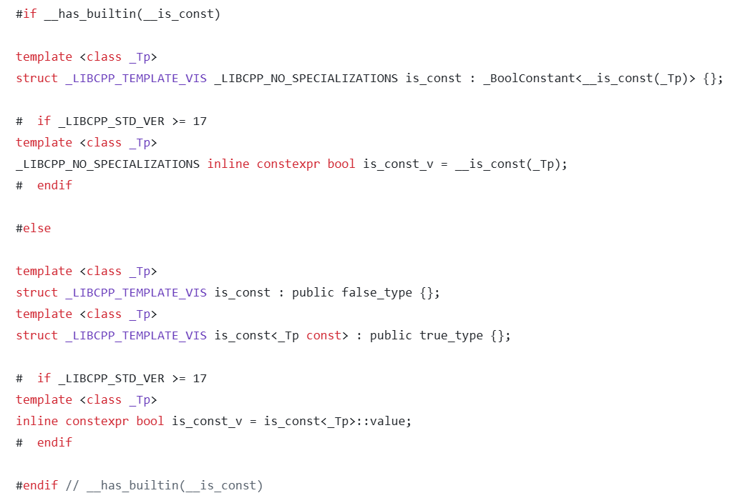
clang (std::is_const)

Slide 36
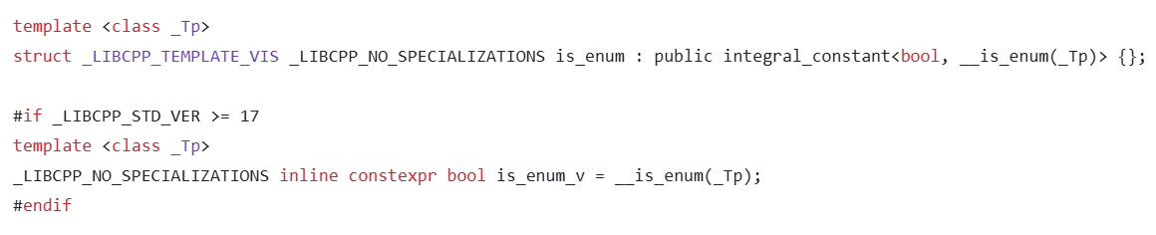
clang (std::is_enunm)

Slide 37
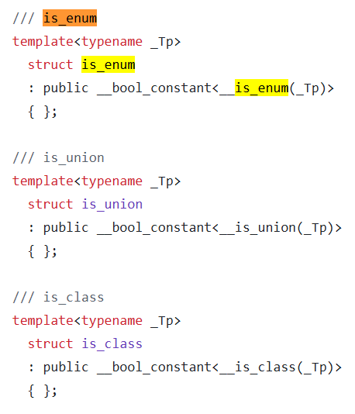
gcc

Slide 38
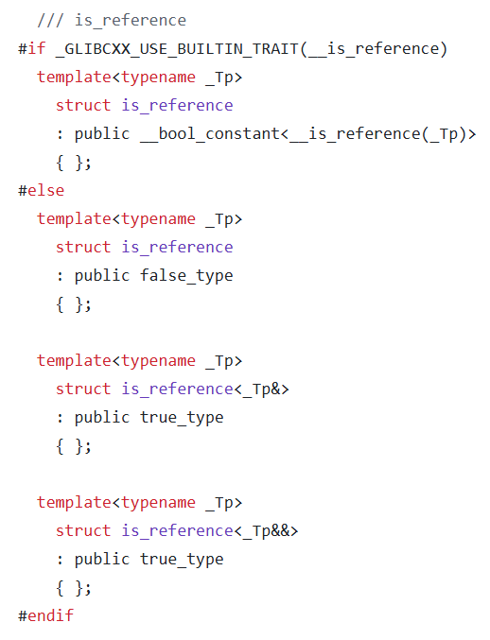
gcc

Slide 39
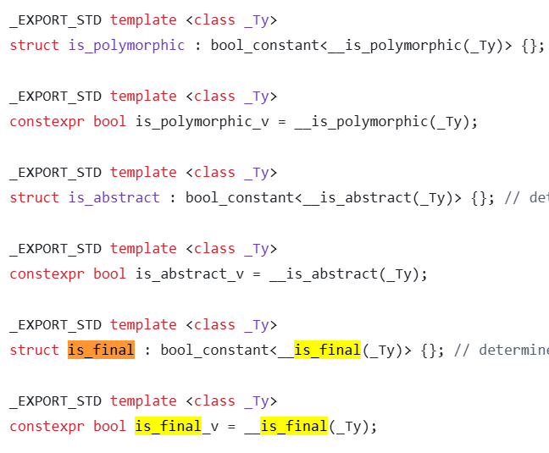
msvc

Slide 40
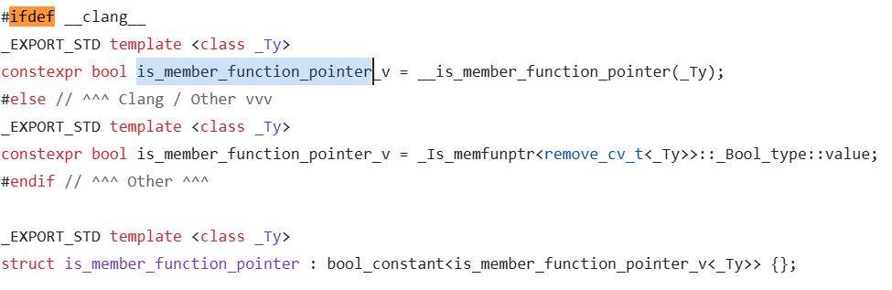
msvc (is_member_function_pointer)

Slide 41
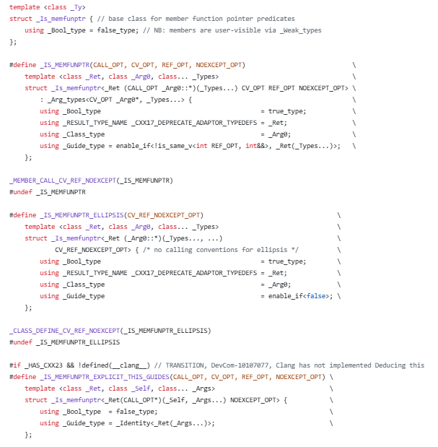
And this is what _Is_memfunptr looks like…

Slide 42

Some Graphs

Slide 43

MSVC

Slide 44
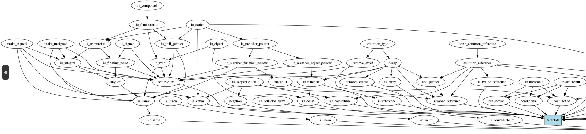
MSVC

Slide 45
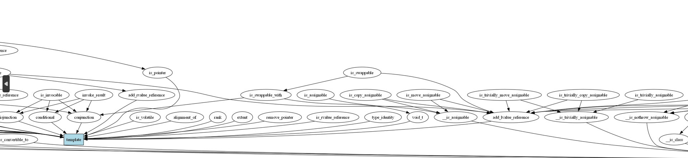
MSVC

Slide 46
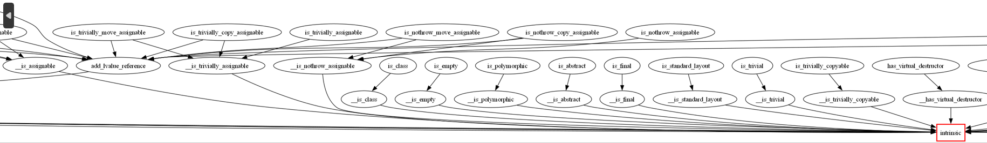
MSVC

Slide 47
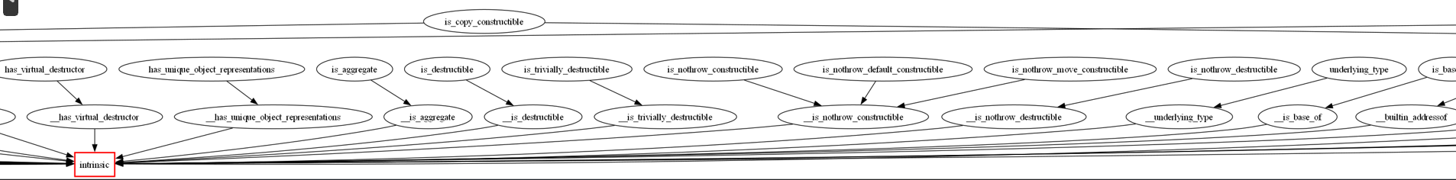
MSVC

Slide 48
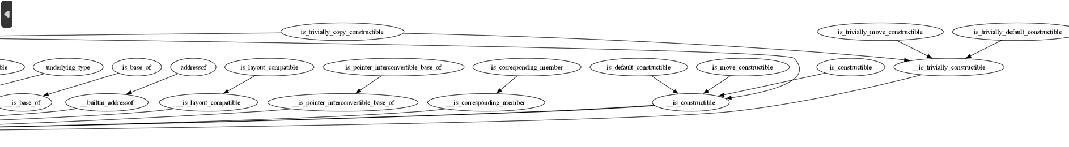
MSVC

Slide 49

CLANG (libcxx)

Slide 50
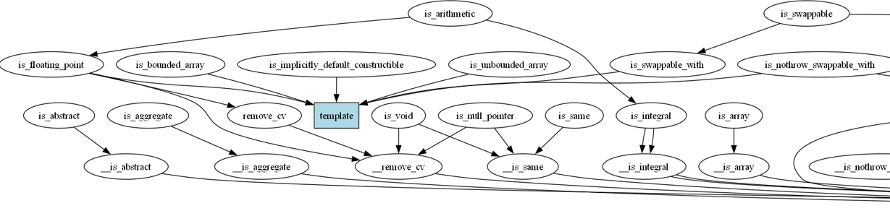
CLANG (libcxx)

Slide 51
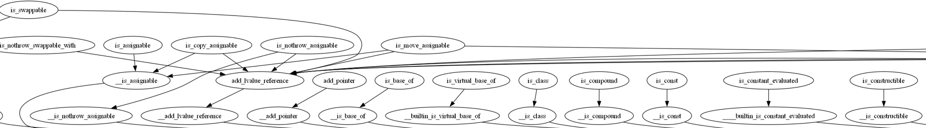
CLANG (libcxx)

Slide 52
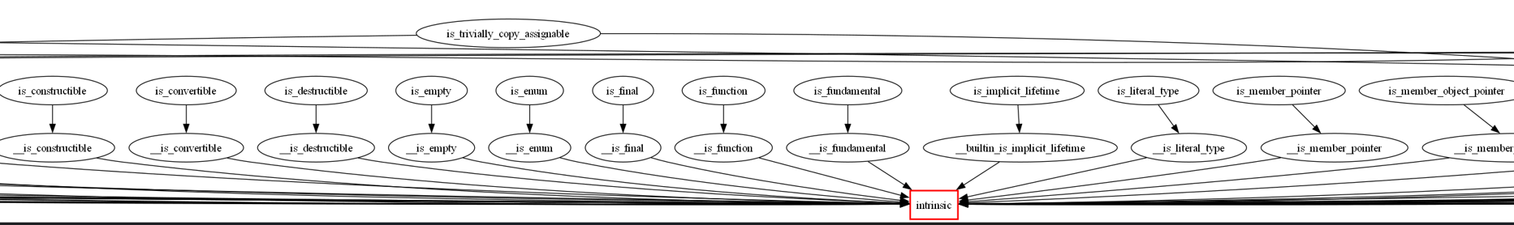
CLANG (libcxx)

Slide 53
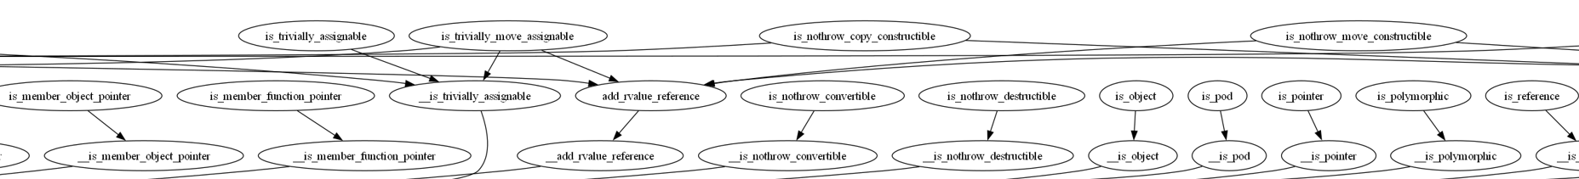
CLANG (libcxx)

Slide 54
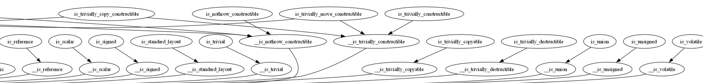
CLANG (libcxx)

Slide 55

GCC (libstd)

Slide 56
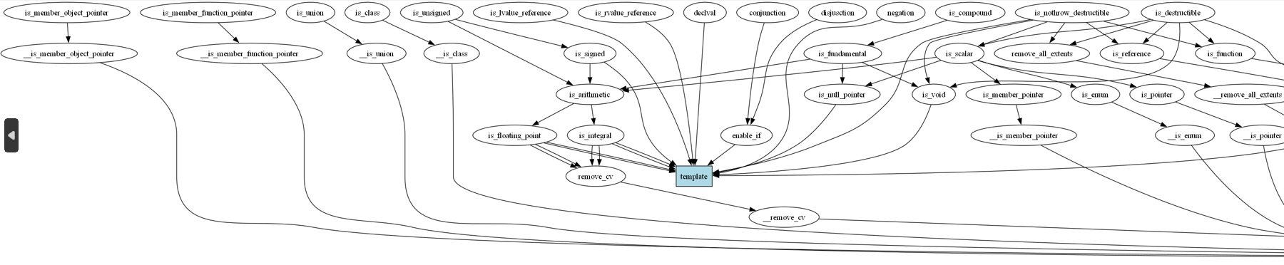
GCC (libstd)

Slide 57
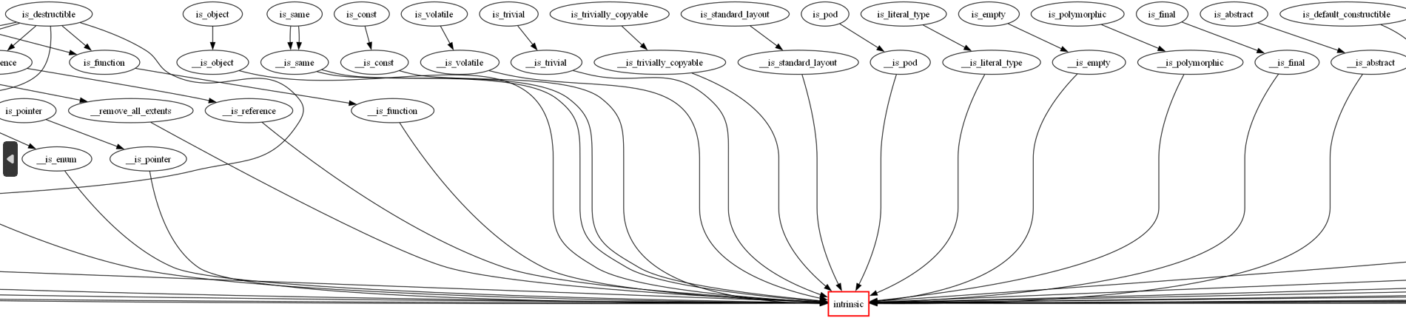
GCC (libstd)

Slide 58
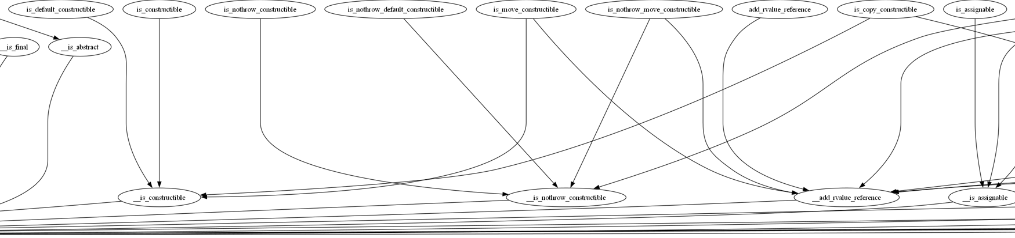
GCC (libstd)

Slide 59
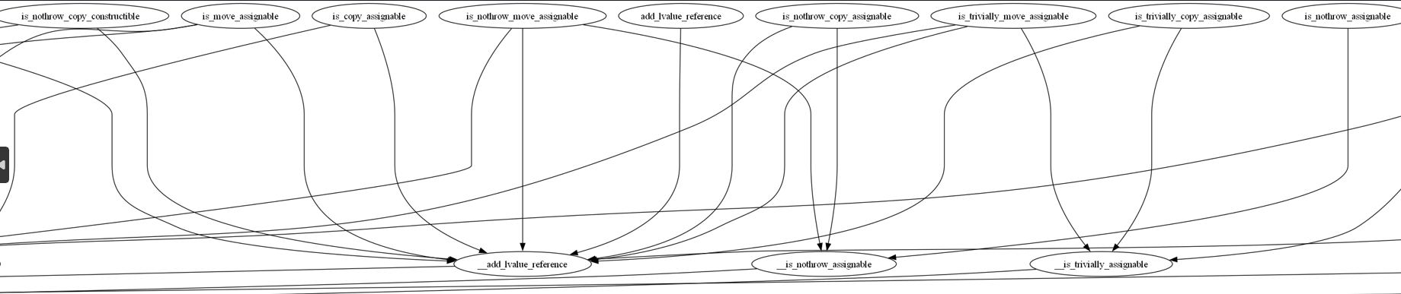
GCC (libstd)

Slide 60
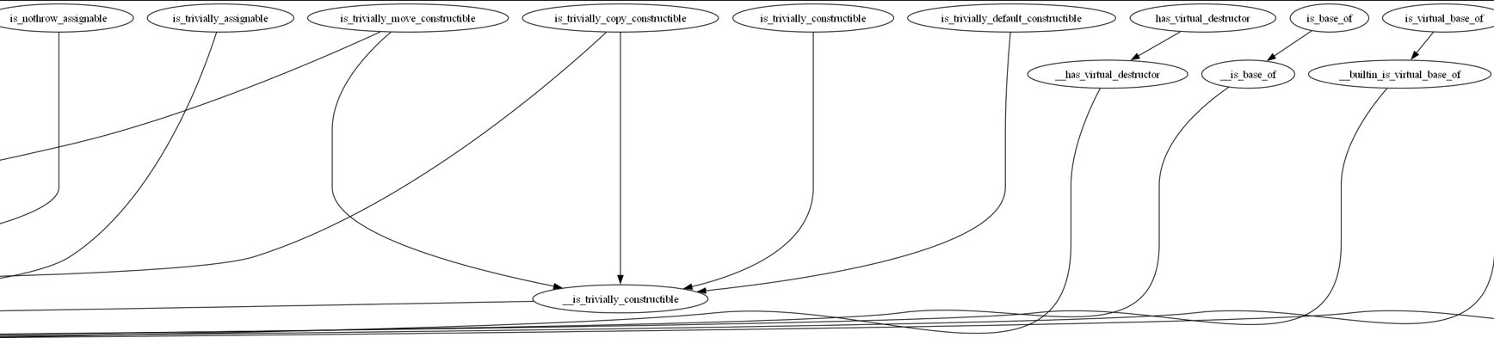
GCC (libstd)

Slide 61

Comparative Analysis

Slide 62
MSVC
Rich (a.k.a complicated (convoluted?) template-based type traits
Late comer into the intrinsics world

Slide 63
CLANG (libcxx)
Most heavily inclined towards intrinsics-based type traits
Probably started like this from the get-go (just my conjecture)

Slide 64
GCC (libstd)
Somewhat of a middle ground between clang and MSVC

Slide 65
Assumptions and Caveats
Intrinsic Implementations
Only intrinsics shown when alternative implementations exist
Standard Type Traits Focus
Analysis focused on standard type traits
Simplified Details
Intermediate templates not shown
Covered only ~half the standard type traits
Focused mainly on is_xxx traits
Potential Errors
Because I’m only human

Slide 66
Cross-Toolchain Supporrt
MSVC -> clang
Libcxx (clang) -> gcc

Slide 67


Current drawbacks and limitations
Implementations are often hard-to-follow pieces of code in the style of logical programming.
Those not based on compiler intrinsics may be slow to compile.
Since they are based on templates
Some of them they may also require future maintenance (e.g. is_integral which is based on a comprehensive types list)
Some traits can only be implemented via "magic" - ~a.k.a intrinsics/builtins
e.g.: is_implicit_lifetime (P2674)
Reflection could trivially replace those magic wands, in a portable manner
Presumably hard to maintain
Hard for users to understand compilation errors (with concepts only partly delivering on this promise)

Slide 68
Static Reflection

Slide 69

What do we mean by “static”?
Static = compile time
Dynamic reflection is more prevalent in other languages

Slide 70

Current State
Targeting C++26 with value-based approach (P2996)
Still in wording phase as of Hagenberg, aiming for plenary in Sofia
Includes introspection but no injection (except splicing and define_aggregate)
Will probably also include expansion statements
No AST modifications - reflection utilities use pure value semantics in Sean Parent style

Slide 71
Current State
Everything currently relies on the opaque type std::meta::info
Motivated mainly by wanting to remain future-compatible with any changes in the C++ type model
Yet type-full wrapper libraries can be built around this
Perhaps even a future standard library
Classes of which would presumably have a conversion function to std::meta::info

Slide 72
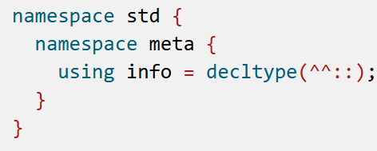
std::meta::info

Slide 73
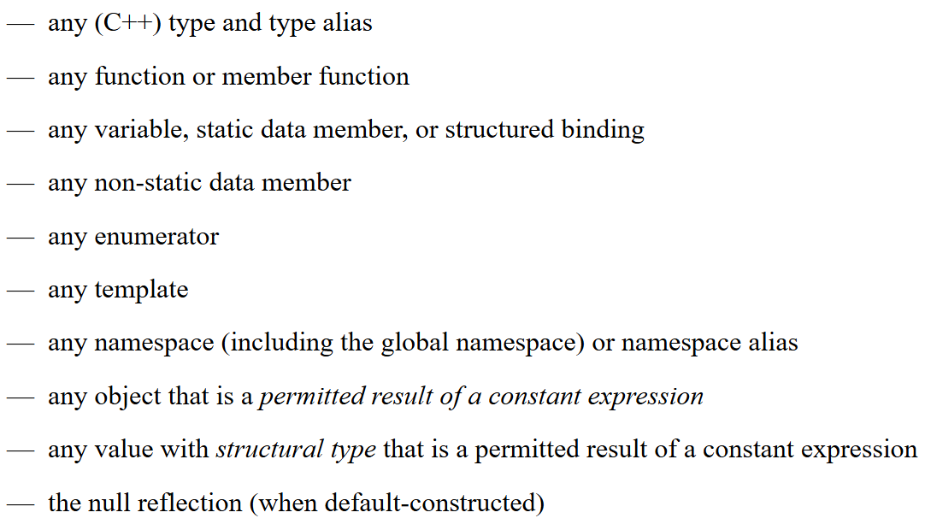
std::meta::info

Slide 74
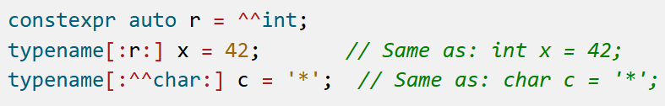
Some Examples from P2996
Back-And-Forth

Slide 75
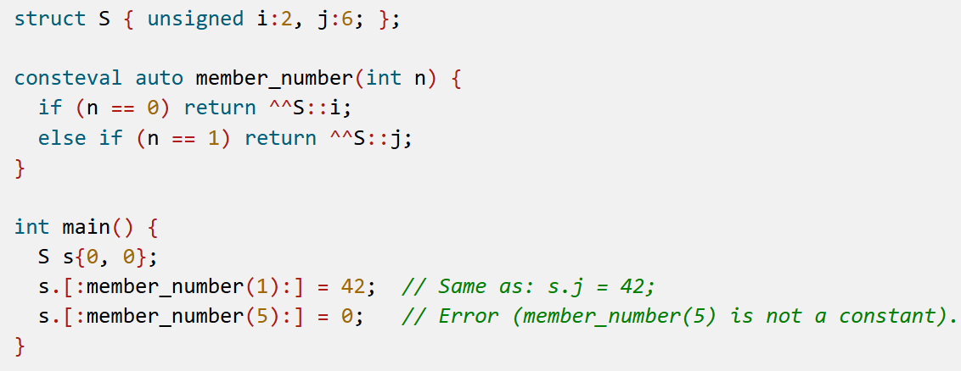
Some Examples from P2996
Selecting Members

Slide 76
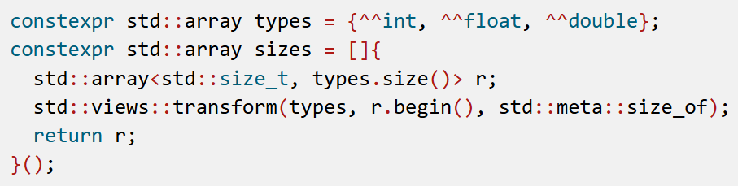
Some Examples from P2996
List of Types to List of Sizes

Slide 77
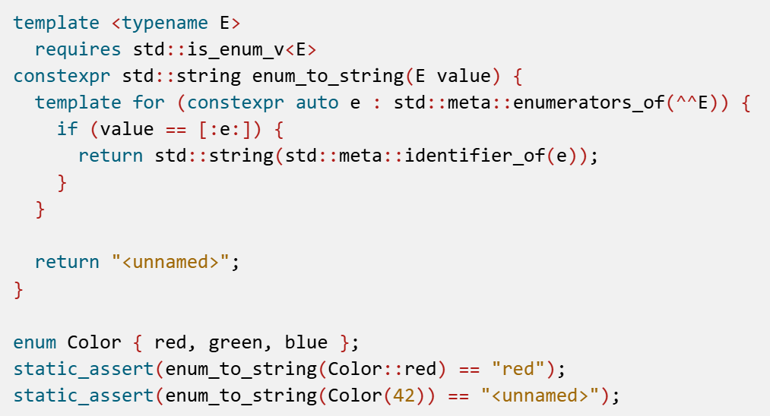
Some Examples from P2996
Enum to String

Slide 78
The Discarded Candidate – Type-Based Reflection
Vs. value-based reflection (the value is meta::info)
Based on a type hierarchy
Would have provided an easier to work with OO API
Main sticking points:
Long compilation times, due to large symbol table
Template instantiations cannot be discarded, giving the compiler a large memory footprint
Not future-proof (language schemes might change)
Or it could stand in the way of such changes

Slide 79
Reflection and Type Traits

Slide 80

Can we get rid of compiler intrinsics and implement type traits via reflection?

Slide 81


Perhaps… Probably… Mostly…
https://compiler-explorer.com/z/https://compiler-explorer.com/z/sq1hKrTj3 -
Conceptual POC written on top of the Bloomberg experimental P2996 implementation on Godbolt
Aided by MS Copilot + Think Deeper
~half the current standard type traits implemented, with no stdlib dependencies

Slide 82
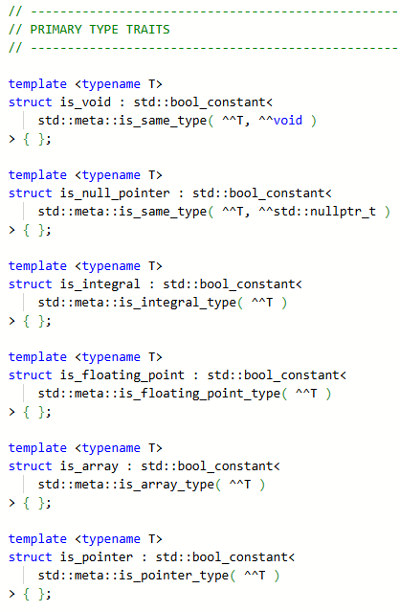

Slide 83
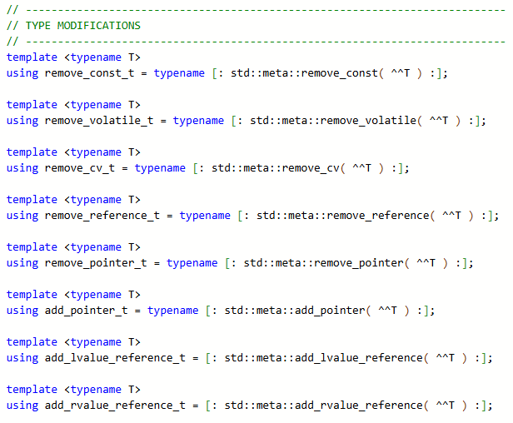

Slide 84
Should we implement all type traits based on reflection?
Definitely worth looking into
Should be faster than complex template-based implementations
But possibly a little slower than direct intrinsics invocations (due to the added thin template layer)
Code would be trivial where matching reflection traits exist
That’s the low hanging fruit we should start with
Not doing this would create 2 sources of truth
Which might diverge if either one is buggy
“In terms of” rocks!

Slide 85
Summary and Future Directions

Slide 86
TLDR
Type traits are an important tool for generic programming
They are mostly implemented via templates and/or compiler intrinsics
Template-based implementations are complicated and hard on the compiler
Static reflection is coming in C++26!
It will be value-based (std::meta::info) and initially will not include code injection
It includes multiple metafunctions, many of which directly mirror existing type traits
Which leads to those type traits apparently being trivially implementable via reflection
Instead of complicated templates and compiler intrinsics
Which begs the question…

Slide 87

Can we have standard library implementations completely independent from toolchains?
<meta> will have to be compiler-specific
Part of the standard library, but not something that can ever have a portable implementation
Which shouldn’t prevent it from having its own dependencies on the standard library, e.g. for strings and containers
Example of a <meta> implementation - from the Bloomberg clang P2996 fork:
https://github.com/bloomberg/clang-p2996/blob/p2996/libcxx/include/experimental/meta
Care must be taken with other stdlib headers having <meta> dependencies, to avoid cyclic dependencies
Perhaps easier with modules?

Slide 88

Key Takeaway
Type traits implemented via reflection may be the key to a future stdlib free-for-all, where standard library implementations aren't tied to any specific toolchain
We can get there gradually by separating the non-generic parts and reducing them over time, hoping we're ultimately left only with <meta>, but in any case we’ll be better off than today
Disclaimer – These are my own opinions. Cross-compiler portability of the standard library is currently not a stated goal of WG21.
If that’s what we want
Possible motivation: combining different vendors’ strengths and velocities in implementing new C++ standards

Slide 89


Thank You for joining me in my reflections on the future!

